Slide 1
Newton’s method

Slide 2
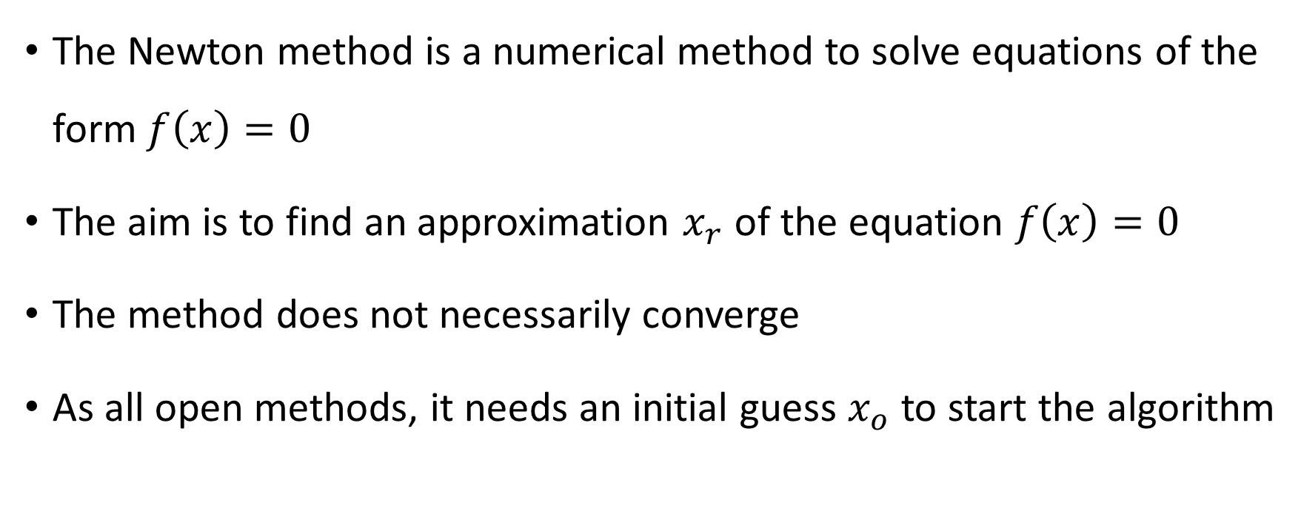
The Newton method is a numerical method to solve equations of the form $f\left(x\right)=0$
The aim is to find an approximation $x_{r}$ of the equation $f\left(x\right)=0$
The method does not necessarily converge
As all open methods, it needs an initial guess $x_{o}$ to start the algorithm
Notes:
In this lecture we cover a second example of an open method: the Newton method
The Newton method solves numerically equations of the form f(x)=0.
It aims to approximate the solution r of the equation f(x)=0
As we will see, the algorithm will not necessarily converge.
As all open methods, you will need to start the algorithm with an initial guess xo.
This initial guess is not provided by the algorithm and you will have to provide it.
For example you can find graphically the solution of the equation and then choose an initial guess close to the solution you determined graphically.

Slide 3

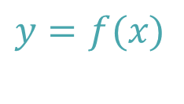





The idea behind Newton’s algorithm
$$y$$
$$y=f(x)$$
$$r$$
$$x_{2}$$
$$x_{1}$$
$$x_{o}$$
$$x$$
Notes:
Let us explain the idea behind Newton's algorithm
The aim is to solve an equation f(x)=0.
This is the same as to locate the root of the function f.
Let us start by plotting the function y=f(x).
This function has a root in r.
We now start by choosing an initial guess xo.
Newton's algorithm will then determine the slope of the function in xo.
It then finds the intercept between the tangent line to f in xo and the x axis.
This intercept will give us the first iteration x1.
Having x1, we proceed the same way again to find x2.
We could go on further like this.
Note how much closer x2 is to the root than xo.
The algorithm, as we will learn is coming lectures, is in fact converging very rapidly to the root r.

Slide 4




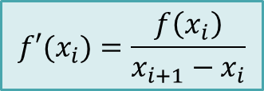

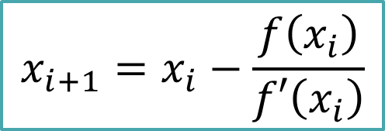
$$y$$
$$y=f(x)$$
$$f′(x_{i})=\frac{f\left(x_{i}\right)}{x_{i+1}−x_{i}}$$
$$x_{i+1}=x_{i}−\frac{f\left(x_{i}\right)}{f′\left(x_{i}\right)}$$
$$r$$
$$x_{i+1}$$
$$x_{i}$$
$$x$$
Notes:
Now we understand the idea of the algorithm we need to find a formula to calculate the next iteration xi+1 from the current iteration xi.
The formula is quite simple.
How can we proof this formula?
A simple way is to look at the highlighted triangle.
If you write down the relation for f’(xi), the slope of the function in xi, the proof is straight forward.
You only need to solve for xi+1.

Slide 5
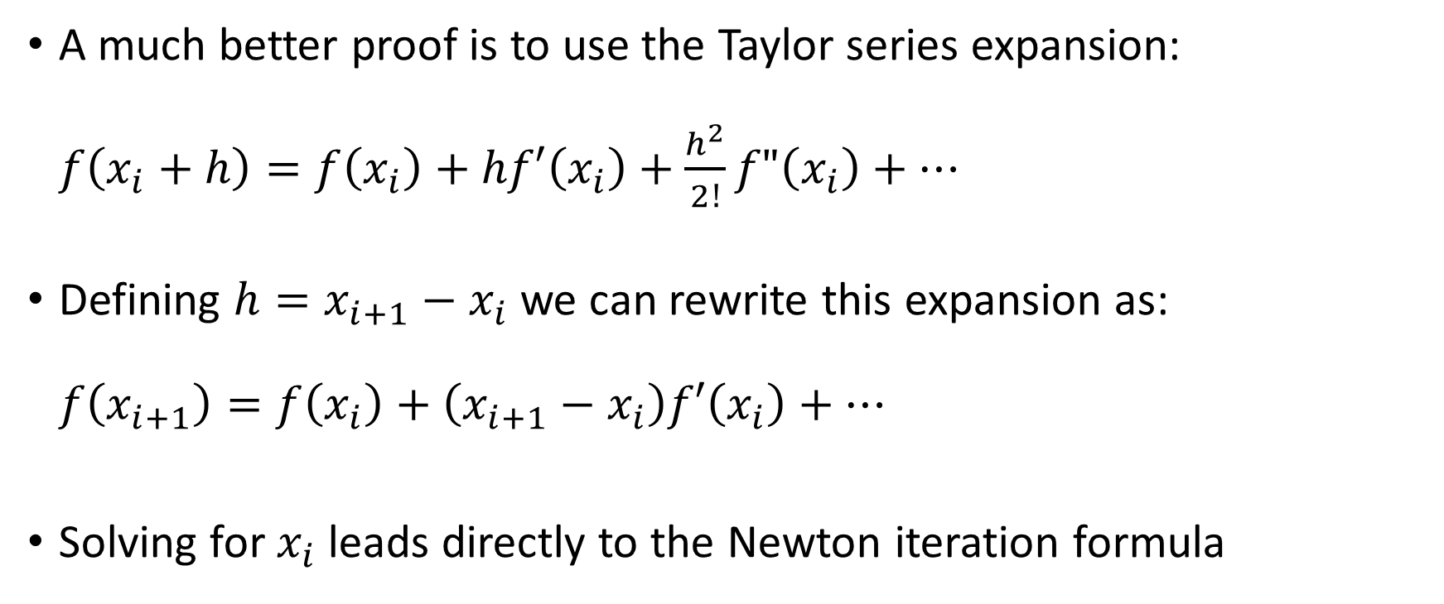
A much better proof is to use the Taylor series expansion: $f\left(x_{i}+h\right)=f\left(x_{i}\right)+hf′\left(x_{i}\right)+\frac{h^{2}}{2!}f"\left(x_{i}\right)+…$
Defining $h=x_{i+1}−x_{i}$ we can rewrite this expansion as: $f\left(x_{i+1}\right)=f\left(x_{i}\right)+\left(x_{i+1}−x_{i}\right)f′\left(x_{i}\right)+…$
Solving for $x_{i}$ leads directly to the Newton iteration formula
Notes:
A much better way to proof it, is to use the Taylor series expansion.
For this let us expand f(x) around xi.
Let us now define h as xi+1-xi.
We can then write our Taylor series expansion again.
Solving this last expression for xi+1, will directly give the formula of the Newton algorithm.
I invite you to try to do it by yourself.

Slide 6
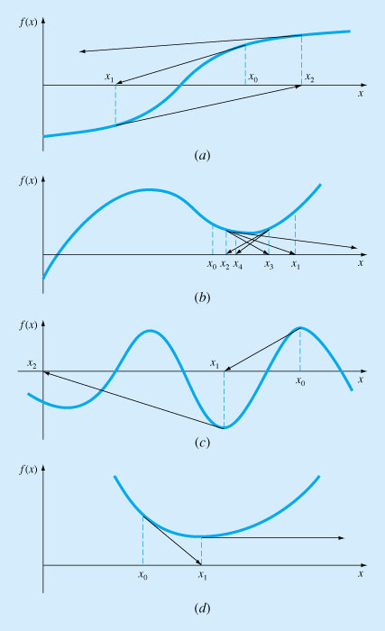
Does the method always converge?
Notes:
Now we know the mechanism of the Newton algorithm we should ask ourselves under which conditions this algorithm will converge to the desired answer.
The displayed figure shows some examples were Newton’s algorithm will not converge.
Four cases are presented, but they are by far not the only one that may occur.
In fact, it is not as simple as for the fixed point iteration algorithm to give a condition under which the Newton’s method will converge.
It is always highly recommended that as a very first step you plot your function from which you want to find the root.
This allows you to get a first initial approximation for the root which you can use as initial guess xo for the algorithm.
Further you can try out on the figure if the algorithm will, or will not, converge.

Slide 7
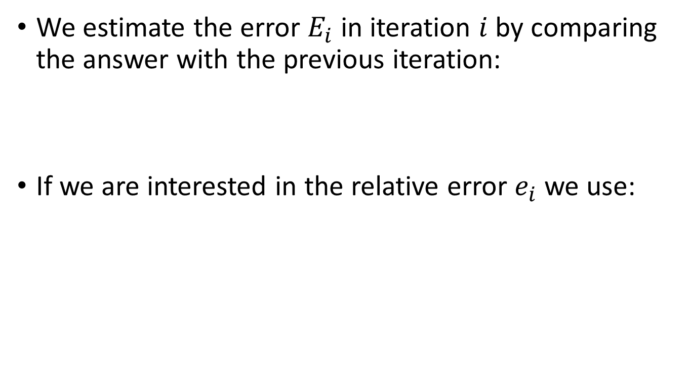


How to estimate the error?
We estimate the error $E_{i}$ in iteration $i$ by comparing the answer with the previous iteration:
If we are interested in the relative error $e_{i}$ we use:
x_{i}
$$E_{i}≅\left|x_{i}−x_{i−1}\right|$$
$$e_{i}≅\left|\frac{x_{i}−x_{i−1}}{x_{i}}\right|$$
Notes:
As of now we know how to apply the mechanics of Newton's algorithm to solve nonlinear equations. We know as well that under the right conditions, the algorithm will converge to the desired solution., meaning that the produced approximations become closer and closer to the answer of our problem.
As for the other methods we learned so far, we would like to be able to estimate the error of a calculated approximation.
Newton’s method is an open methods, as was the fixed point iteration method.
To estimate the error at iteration number i, we compare the produced approximation with the previous approximation, as we did for the fixed point iteration method.
If we are interested in the relative error rather than the absolute error, we can use the ratio between xi-xi-1 and xi.
As for the fixed point iteration method, we have to be careful when using this way to estimate the error in iteration number i.
We will have to learn more fundamentals before we can evaluate correctly if the method of error estimation we are using is appropriate or not.
Let me already mention now that we will replace this method with a more accurate one.

Slide 8

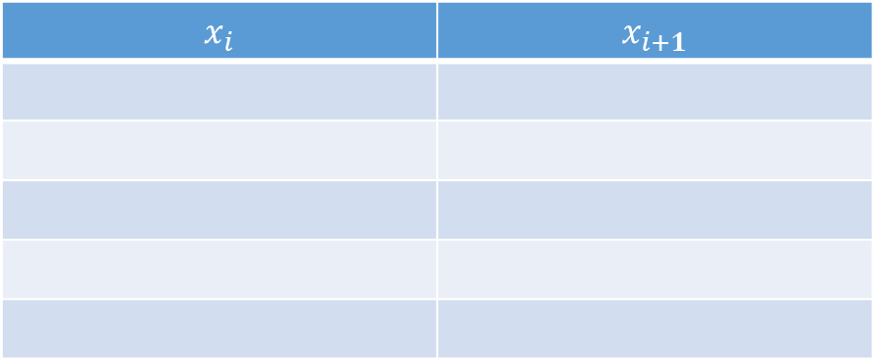
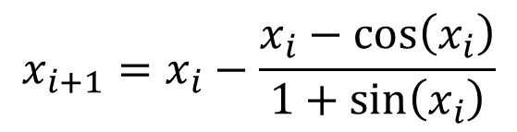
An example
$$x_{i+1}=x_{i}−\frac{x_{i}−cos⁡\left(x_{i}\right)}{1+sin⁡\left(x_{i}\right)}$$
$$x−\cos{x}=0$$
$$x_{i}$$ | $$x_{i+1}$$
Notes:
Let us do a simple numerical example.
For this example we want to solve the equation x-cos(x)=0.
First we write down the Newton iteration scheme.
Then we want to fill out a table to help us to keep track of the calculations.

Slide 9
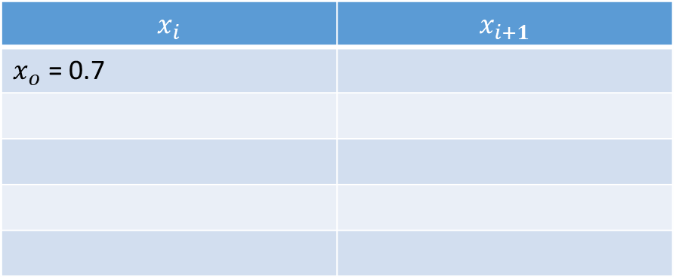
An example
$$x_{i+1}=x_{i}−\frac{x_{i}−cos⁡\left(x_{i}\right)}{1+sin⁡\left(x_{i}\right)}$$
$$x−\cos{x}=0$$
$$x_{i}$$ | $$x_{i+1}$$
$x_{o}$ = 0.7
Notes:
We need as well an initial condition xo.
In the present case we choose xo=0.7.
How did we choose that value? We did choose it based on a graphical solution of the equation and approximating the root r on the graph.
I invite you to try to do this graphical solution by yourself.

Slide 10
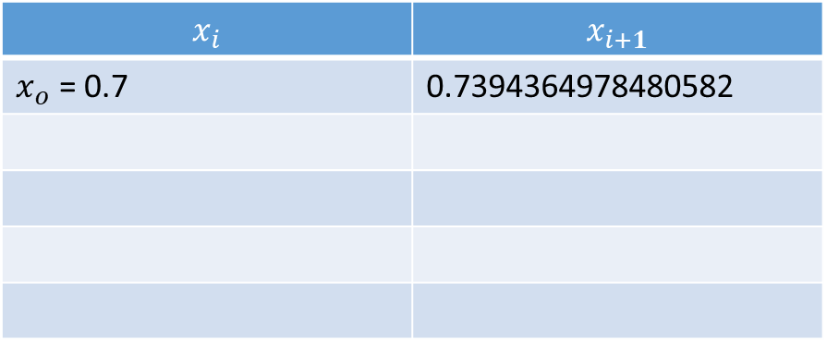
An example
$$x_{i+1}=x_{i}−\frac{x_{i}−cos⁡\left(x_{i}\right)}{1+sin⁡\left(x_{i}\right)}$$
$$x−\cos{x}=0$$
$$x_{i}$$ | $$x_{i+1}$$
$x_{o}$ = 0.7 | 0.7394364978480582
Notes:
Applying a first time the algorithm allows us to find x1
We copy this value to the next line in the table.

Slide 11
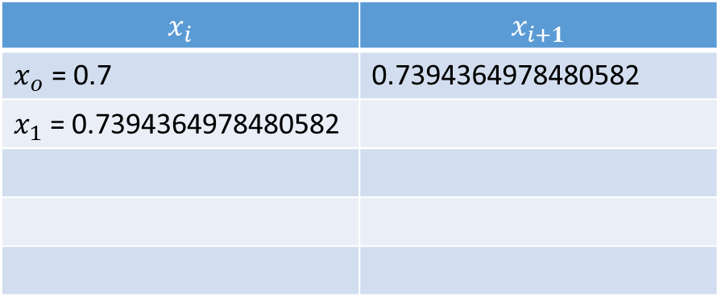
An example
$$x_{i+1}=x_{i}−\frac{x_{i}−cos⁡\left(x_{i}\right)}{1+sin⁡\left(x_{i}\right)}$$
$$x−\cos{x}=0$$
$$x_{i}$$ | $$x_{i+1}$$
$x_{o}$ = 0.7 | 0.7394364978480582
$x_{1}$ = 0.7394364978480582

Slide 12
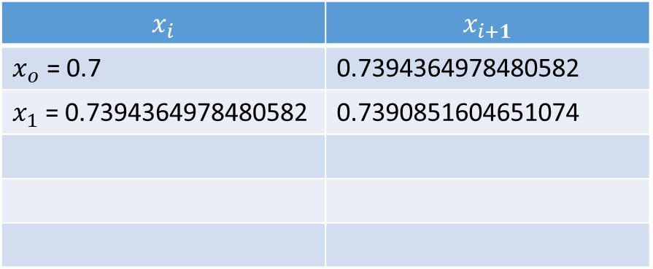
An example
$$x_{i+1}=x_{i}−\frac{x_{i}−cos⁡\left(x_{i}\right)}{1+sin⁡\left(x_{i}\right)}$$
$$x−\cos{x}=0$$
$$x_{i}$$ | $$x_{i+1}$$
$x_{o}$ = 0.7 | 0.7394364978480582
$x_{1}$ = 0.7394364978480582 | 0.7390851604651074
Notes:
Based on x1, we can compute x2.
Again we copy the value to the next line in the table.

Slide 13
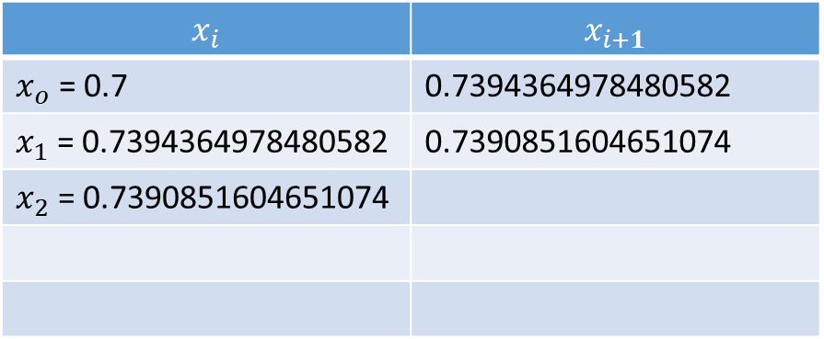
An example
$$x_{i+1}=x_{i}−\frac{x_{i}−cos⁡\left(x_{i}\right)}{1+sin⁡\left(x_{i}\right)}$$
$$x−\cos{x}=0$$
$$x_{i}$$ | $$x_{i+1}$$
$x_{o}$ = 0.7 | 0.7394364978480582
$x_{1}$ = 0.7394364978480582 | 0.7390851604651074
$x_{2}$ = 0.7390851604651074

Slide 14
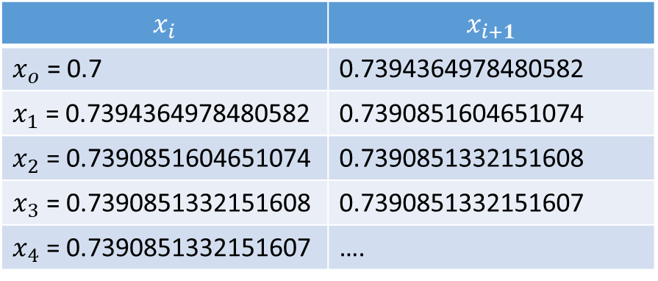
An example
$$x_{i+1}=x_{i}−\frac{x_{i}−cos⁡\left(x_{i}\right)}{1+sin⁡\left(x_{i}\right)}$$
$$x−\cos{x}=0$$
$$x_{i}$$ | $$x_{i+1}$$
$x_{o}$ = 0.7 | 0.7394364978480582
$x_{1}$ = 0.7394364978480582 | 0.7390851604651074
$x_{2}$ = 0.7390851604651074 | 0.7390851332151608
$x_{3}$ = 0.7390851332151608 | 0.7390851332151607
$x_{4}$ = 0.7390851332151607 | ….
Notes:
We can proceed this way for further iterations.
In the present case we went until x4.
Now we did some iterations, let us estimate the errors of each iteration.

Slide 15
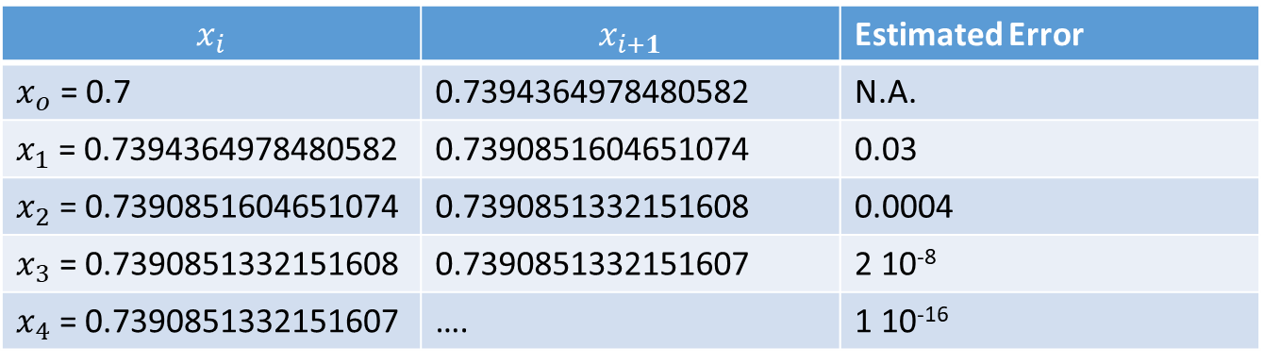
An example
$$x_{i+1}=x_{i}−\frac{x_{i}−cos⁡\left(x_{i}\right)}{1+sin⁡\left(x_{i}\right)}$$
$$x−\cos{x}=0$$
$$x_{i}$$ | $$x_{i+1}$$ | Estimated Error
$x_{o}$ = 0.7 | 0.7394364978480582 | N.A.
$x_{1}$ = 0.7394364978480582 | 0.7390851604651074 | 0.03
$x_{2}$ = 0.7390851604651074 | 0.7390851332151608 | 0.0004
$x_{3}$ = 0.7390851332151608 | 0.7390851332151607 | 2 10⁻⁸
$x_{4}$ = 0.7390851332151607 | …. | 1 10⁻¹⁶
Notes:
For this, we add a further column in which we estimate the error based on the presented method.
Recall that the error estimate is computed based on the difference between xi and xi-1.
Note how the error decreases very fast.
You may remember the calculations we did on the same equation for the fixed point iteration method.
At that time, the error didn’t decrease as fast.
The ability to converge quickly to the root of an equation is one of the interesting properties of the Newton algorithm.
In coming lectures we will learn how we can quantify the speed of convergences for a given algorithm and how we can compare algorithms in term of speed of convergence.

Slide 16
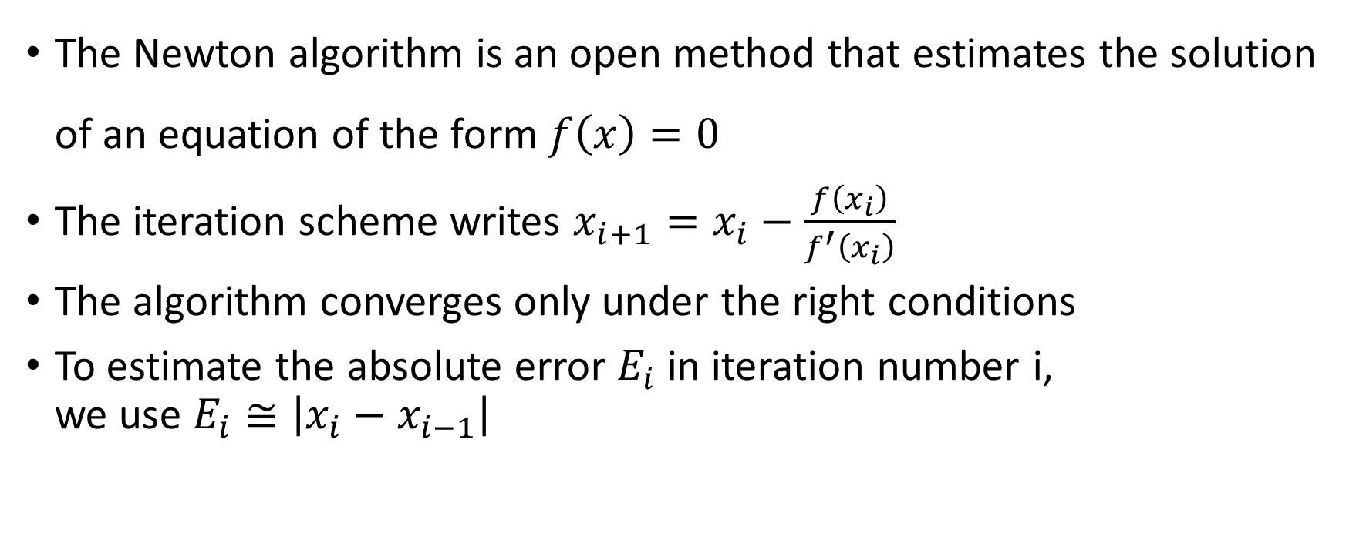
Summary
The Newton algorithm is an open method that estimates the solution of an equation of the form $f\left(x\right)=0$
The iteration scheme writes $x_{i+1}=x_{i}−\frac{f\left(x_{i}\right)}{f^{′}\left(x_{i}\right)}$
The algorithm converges only under the right conditions
To estimate the absolute error $E_{i}$ in iteration number i, we use $E_{i}≅\left|x_{i}−x_{i−1}\right|$
Notes:
Let us summarize the key findings
The Newton algorithm is an open method that estimates the solution of an equation of the form $f\left(x\right)=0$
The iteration scheme writes $x_{i+1}=x_{i}−\frac{f\left(x_{i}\right)}{f^{′}\left(x_{i}\right)}$
The algorithm converges only under the right conditions
To estimate the absolute error in iteration number i, we use the difference between the current and previous iteration

